Slide 1
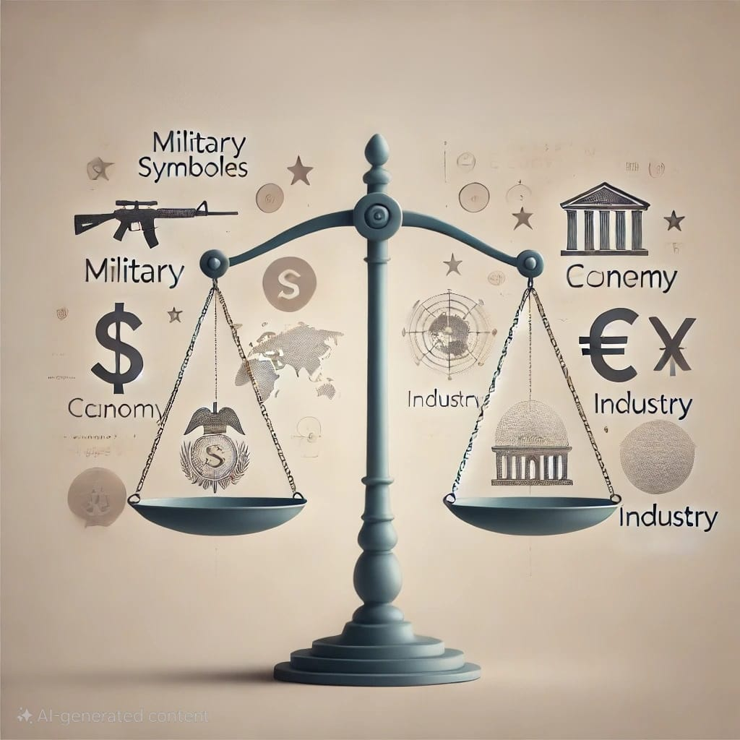
The Economic Consequences of Military Rule
Presented By Sakib Al Hasan

Slide 2

A.G.M NIAZ UDDIN
PRESENTED TO:
Associate Professor
Department of Political Science
University of Chittagong

Slide 3
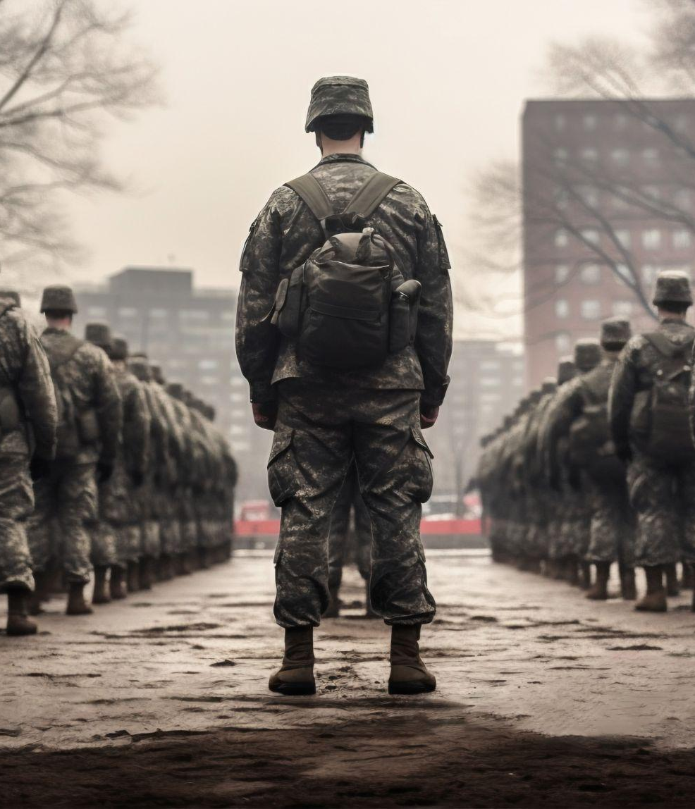
Introduction
A military rule is a form of government in which the military holds most or all political power. Military rules may be ruled by a single high-ranking military officer or by a group of such officers. Military rules are notorious for human rights abuses and the denial of political and social freedoms.
Military rule, where the government is controlled by the armed forces, often emerges in countries experiencing political instability, corruption, or civil unrest. A simple way to think of it is the situation in which the army says: ‘Now we are in charge.’ In this configuration, elections cease to matter, the constitution is suspended, and the government rules by decree. Instead of the usual bureaucratic processes, a small group of military officials make the decisions for the country.

Slide 4
Examples of Countries Affected by Military Rule
Egypt
1952-2011, 2013-present
Pakistan
1958-1971, 1977-1988, 1999-2008
Nigeria
1966-1979, 1983-1999
Thailand
1976-1977, 1991-1992, 2006-2007, 2014-present
Myanmar
1962-2011, 2021-present

Slide 5

Economic Characteristics of Military Rule
Centralized Control:
Military regimes often centralize economic decision-making, reducing public and private sector autonomy.
Prioritization of Security Over Economy:
Budget allocation often favors military expenditures over economic development.
Restriction of Economic Freedoms:
Military governments tend to impose restrictions on businesses, trade unions, and civil society, affecting economic innovation and growth.
Corruption:
Military leaders and their affiliates may misuse resources, leading to widespread corruption.

Slide 6
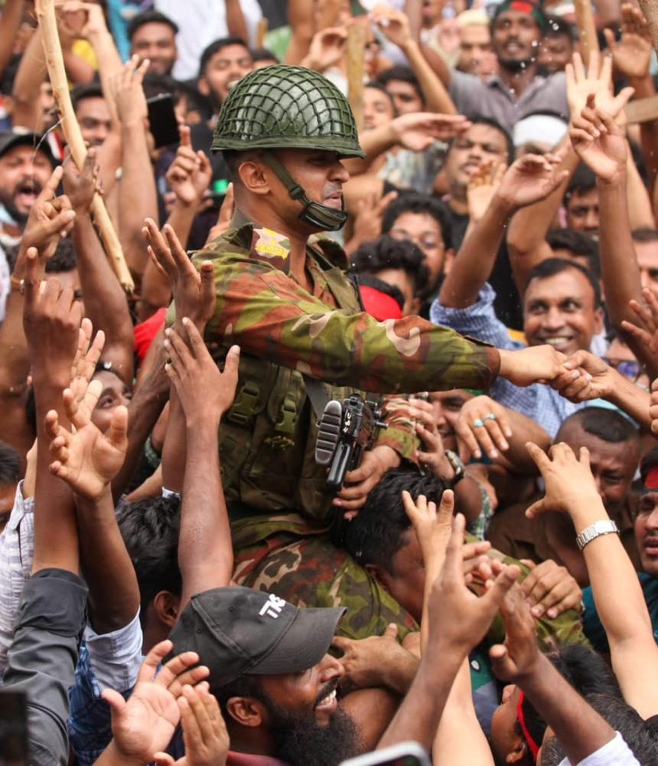
Short-Term Economic Consequences
Instability and Investment Withdrawal:
Political instability discourages both foreign and domestic investment.
Companies may pull out, fearing unpredictable policies or nationalization of assets.
Increased Defense Spending:
Military regimes often allocate significant funds to the defense sector, reducing resources for other areas such as healthcare, education, and infrastructure.
Example: Myanmar’s military government heavily prioritized defense, which reduced funds for social development.
Currency and Inflation Issues:
Exchange rates may be artificially controlled, leading to black-market economies and inflation.
Inflation often rises due to ineffective economic policies and increased state spending on the military.

Slide 7
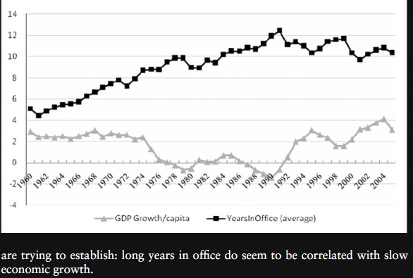
Long-Term Economic Consequences
Slow Economic Growth
Decreased Human Capital Investment
Weak Institutional Development
Isolation from the International Community
Dependency on Specific Alliances
Increase in Poverty Rates
Widening Income Inequality
Corruption in Military Regimes
Brain Drain:
Conflict and Violence

Slide 8
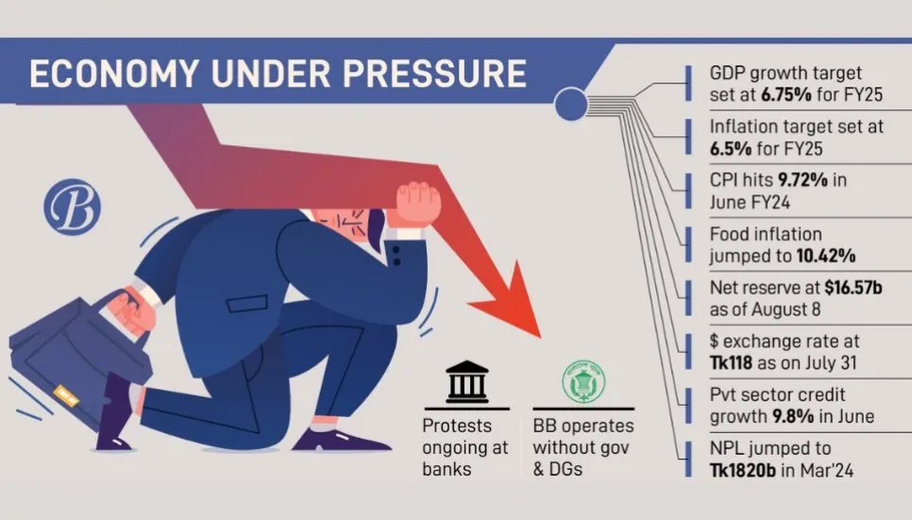
Economic Challenges Post-Military Rule
Debt Accumulation:
Countries often accumulate debt under military rule, which future civilian governments struggle to manage.
Example: Argentina’s military dictatorship (1976-1983) left a legacy of debt.
Institutional Rebuilding:
Civilian governments face the challenge of rebuilding democratic institutions and trust.
Economic recovery is slowed by the need for extensive reform.

Slide 9
Conclusion
Summary of Key Points:
Military rule generally leads to negative economic consequences, including slower growth, reduced human capital investment, increased corruption, and economic instability.
Final Thoughts:
Long-term economic development benefits from democratic governance, transparency, and institutional stability.

Slide 10

Thanks
For your valuable time to listen us.
Tutorial group “Cha”
Session: 2019-20
Department of Political Science
University of Chittagong

Slide 11
Resources
Cohen, S. P. The Idea of Pakistan. Brookings Institution Press, 2004.
Jalal, A. The Struggle for Pakistan: A Muslim Homeland and Global Politics. Harvard University Press, 2014.
Steinberg, D. I. Burma/Myanmar: What Everyone Needs to Know. Oxford University Press, 2013.
https://www.researchgate.net/publication/272011448_The_dictator_effect_How_long_years_in_office_affect_economic_development
https://www.thoughtco.com/military-dictatorship-definition-and-examples-5091896
https://www.factsmostly.com/advantages-and-disadvantages-of-military-rule/
Teti, A., Gervasio, G., & Gienger, V. The Arab Uprisings in Egypt, Jordan and Tunisia: Social, Political and Economic Transformations. Palgrave Macmillan, 2020.

